Slide 1

Fundamental Problem Solving and Programming
Core Programming Skills 3
Amizzuddin Amin

Slide 2
Table of Content
Introduction to C
Installation and setup guide
C Basics
Activities

Slide 3
Introduction to C
Why learn C programming?
It is a general-purpose programming language that is simple and flexible.
C had a huge influence on modern-day language which borrow heavily on it.
C++ includes all features of C, but adds classes and other features to support object-oriented programming(OOP).
Java is based on C++ and therefore inherits many features of C.
C# is derived from java and C++
In other words, if you know C; you can grasp the knowledge of other programming languages that adopt the concept of C.

Slide 4
Introduction to C
Advantages
Disadvantages
Efficient – It can run quickly and in limited amount of memory
Portability – when a program must run on computer from PC to supercomputer, it is often written in C.
Flexibility – C imposes very few restrictions such that operations would be illegal in other language but often permitted in C (for example a char data type add with a integer data type).
Error prone – C’s flexibility makes it error prone language such that programming mistake that would caught by other languages can’t be detect by C compiler.
Difficult to understand – it has a number of features that aren’t found in all programming language. These features can be combined in variety ways which a program can be simple to the original program author but can be hard for others to understand.
Difficult to modify – Large C program can be hard to modify if it’s designed didn’t consider maintenance in mind.

Slide 5
Introduction to C
What is the effective use of C?
Learn to avoid C pitfalls.
Use software tools to make programs more reliable. Using a good debugger is practically mandatory for C programmers. (that is the reason why we adopt Microsoft Visual Studio Code)
Take advantage of existing code libraries. This can help to reduce errors and save a lot of programming effort.
Adopt a sensible set of coding convection. Well chosen convection help make programs more uniform, easier to read and easier to modify.
Avoid “tricks” and overly complex code. Don’t go for short code that is hard for other’s to comprehend.
Click here to return to table of content

Slide 6
Installation and setup guide Content page
Microsoft Visual Studio Code installation guide
C/C++ extension for VS code
Mingw-w64 GCC compiler installation
1st program Hello World!
Compile & run C (part 1) – Typing commands
Compile & run C (part 2) – Commands using tasks
Compile & run C (Part 3) – Keyboard shortcuts for tasks
Debugging setup

Slide 7
Introduction to Microsoft Visual studio Code
Why MS visual studio code?
It is light weight but powerful source code editor.
Rich ecosystem of extensions for other language.

Slide 8
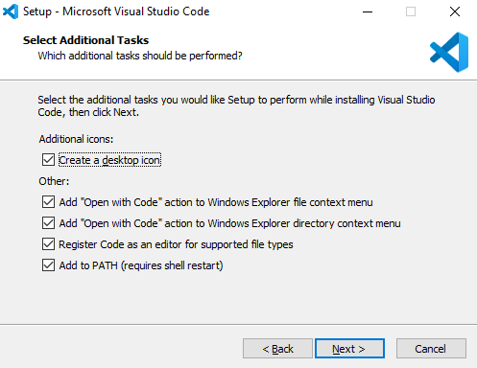
MSVC installation guide
NOTE: Please follow the guide carefully, your program may not work well if you skip or did not follow the step as shown.
Download the visual studio code installer here.
You may checked all the boxes during the installation setup
Wait until installation complete and you’re done!

Slide 9
MSVC installation guide
Now, can we start programming?
The answer is Yes and No
As mentioned earlier, MSVC is a source code editor. Meaning you can create a source file, but still lacking of necessary files to compile the source file into an executable (.exe) file. On the next section, we will cover on how to install the extensions for the programming languages which we will use for this course.
Click here to return to Table of content
Click here to return to Installation and setup guide content page

Slide 10

C/C++ extension installation guide
Open the Visual Studio Code application.
Click “Extensions” (4 square icon) on the left panel of the VS application display.
Search for C/C++ extension by Microsoft.
Click on the Install button.
For steps 2 to 4, proceed to the next slide to see how to progress these steps on application.

Slide 11
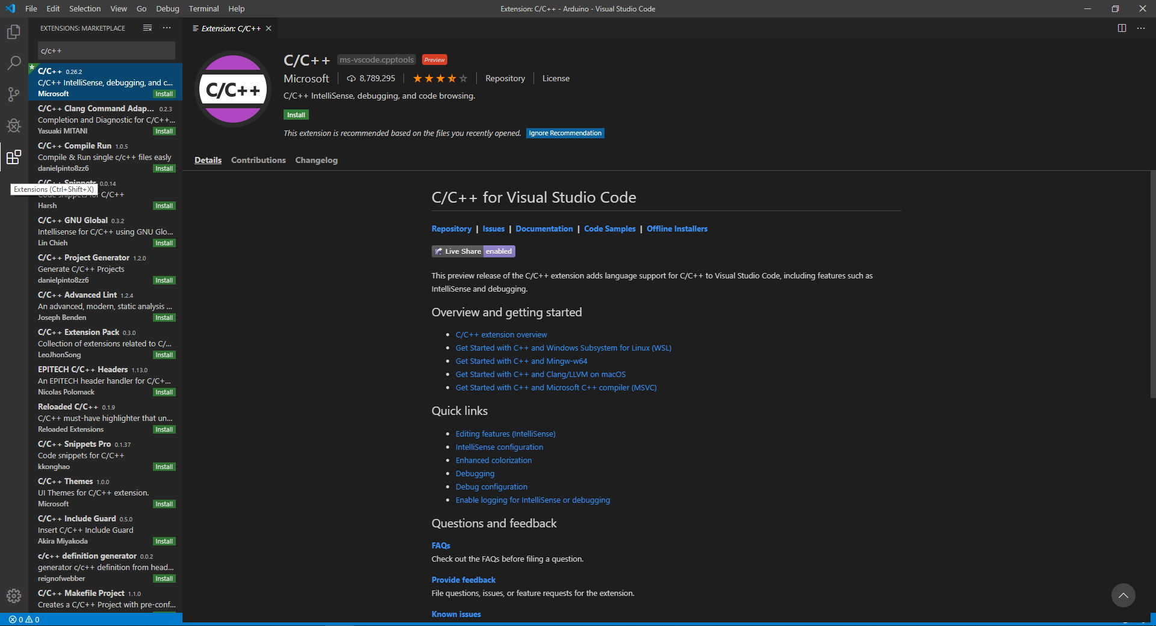
Step 4, Click on the install button
Step 3, Search for C/C++ by Microsoft
Step 2, Click “Extensions”

Slide 12
Mingw-w64 GCC installation guide
Once installation completed, you will need to reload the MSVC application which can be done on the same Extension page.
Next, create a folder name “mingw-w64” on the C:\ directory.
Please refer next slide for more info.

Slide 13
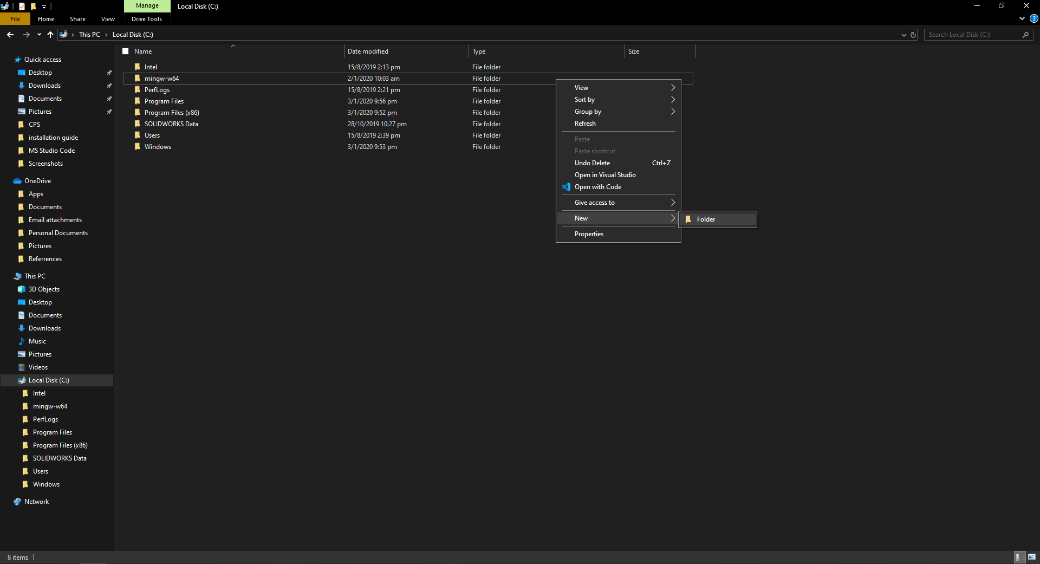
5b) name the new folder “mingw-w64”
5a) create a new folder at c:/ directory

Slide 14
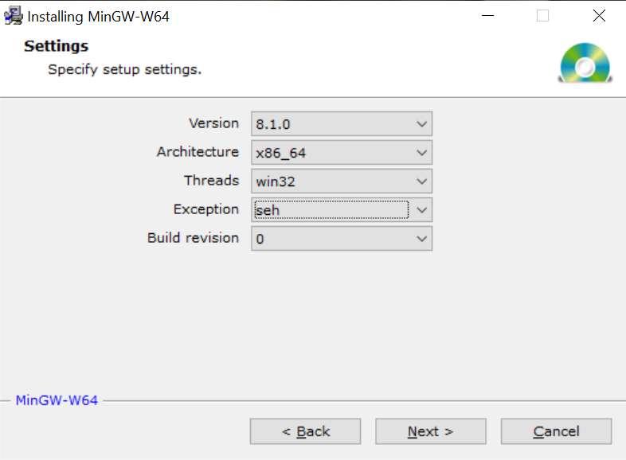
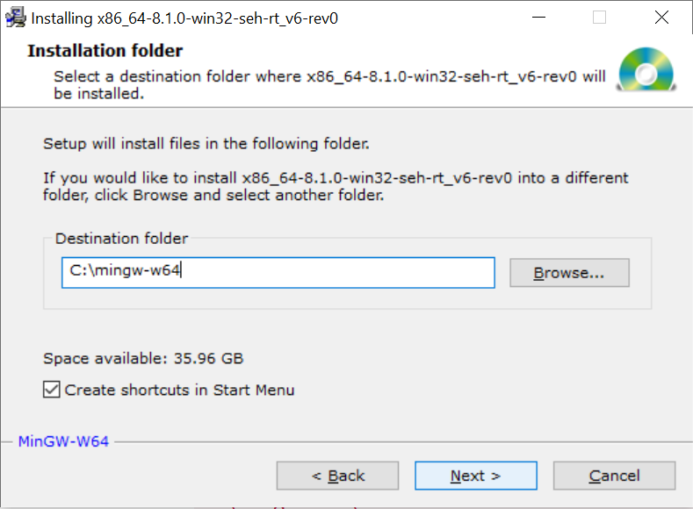
Mingw-w64 GCC installation guide
Download the mingw-w64 GCC compiler here.
In the setup setting, choose the following setting.
In the installation folder, browse and select the folder which you’ve created earlier.

Slide 15
Final steps to C installation guide
We need to add mingw-w64 bin folder into the Windows PATH environment variable.
Locate and copy the link to mingw-w64 bin folder.
Type “edit” on the search button located on left bottom of your screen.
Click on “Edit environment variables for your account”
Click on Path for User Variables for <your username>
Click on New and paste the link which you copied earlier.
Click on OK and you’re done!
Please refer next slide for more info.

Slide 16
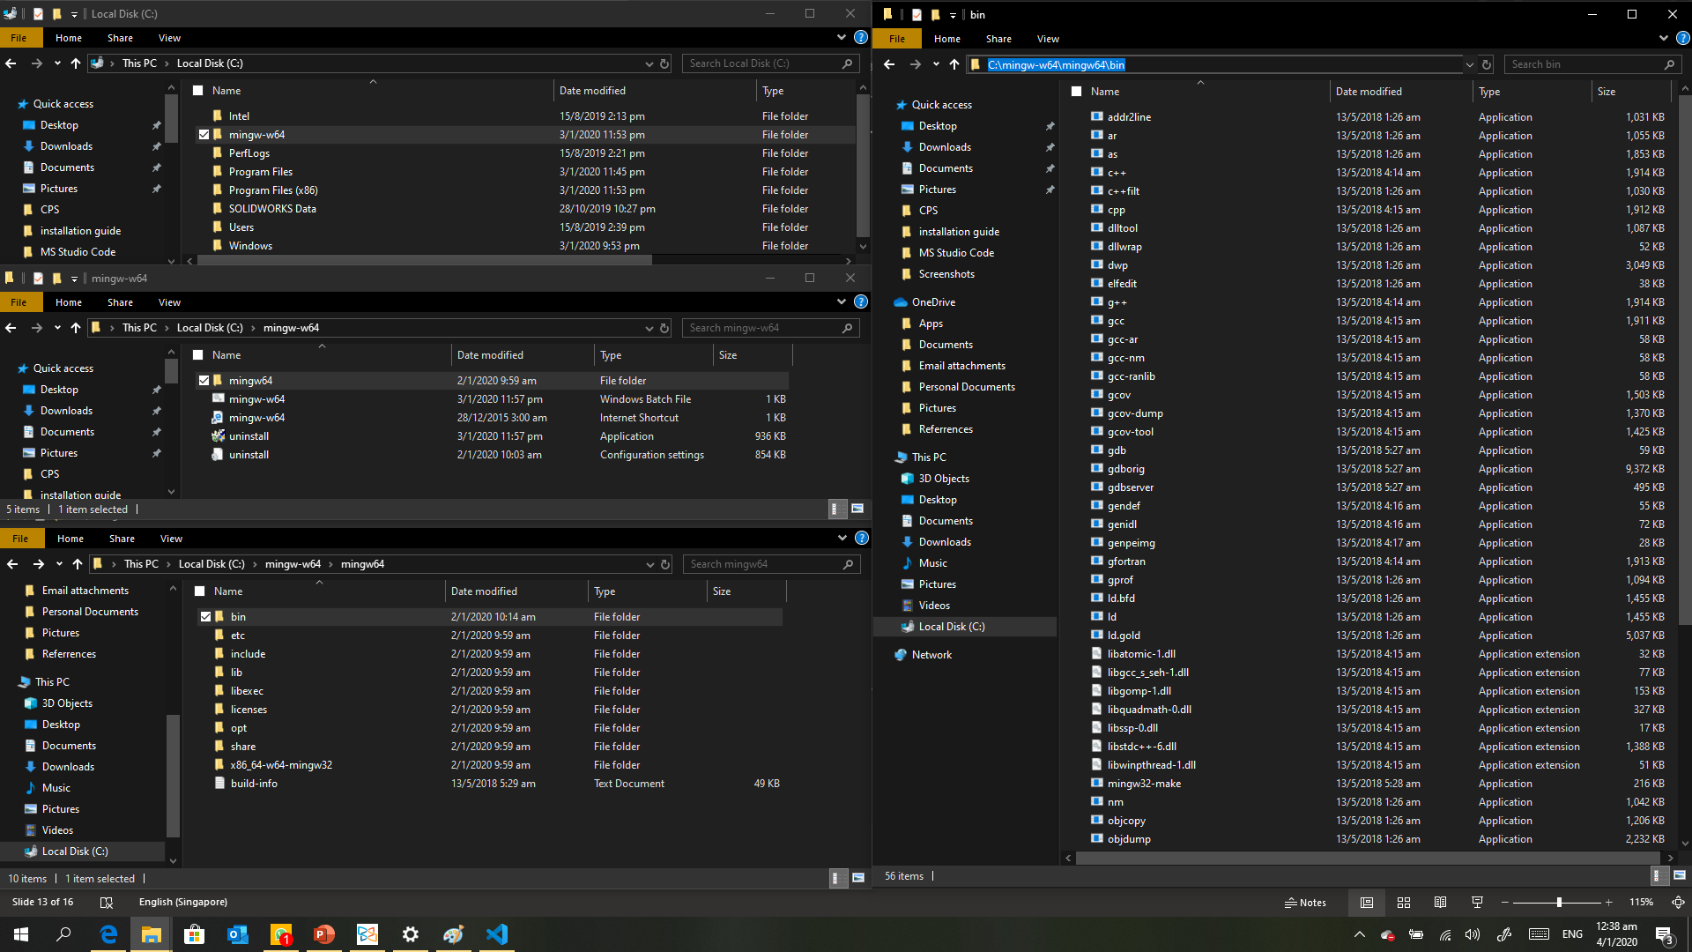
11 a) Locate mingw-w64 folder in c:/ directory
11 d) Copy the bin folder link!
11 b) Locate mingw64 folder in c:/directory/mingw-w64
11 c) Locate bin folder in c:/directory/mingw-w64/mingw64

Slide 17
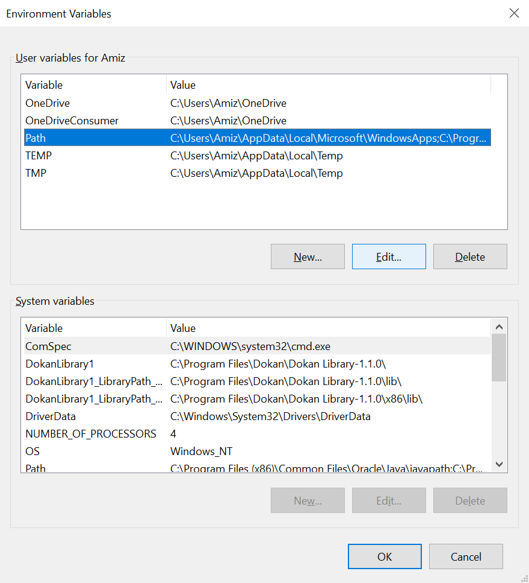
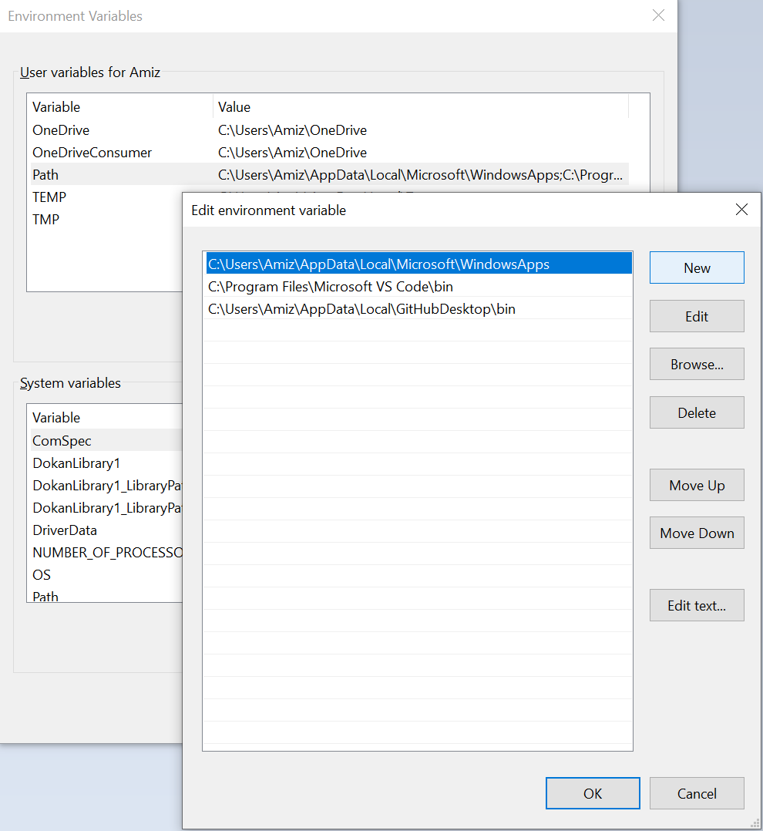
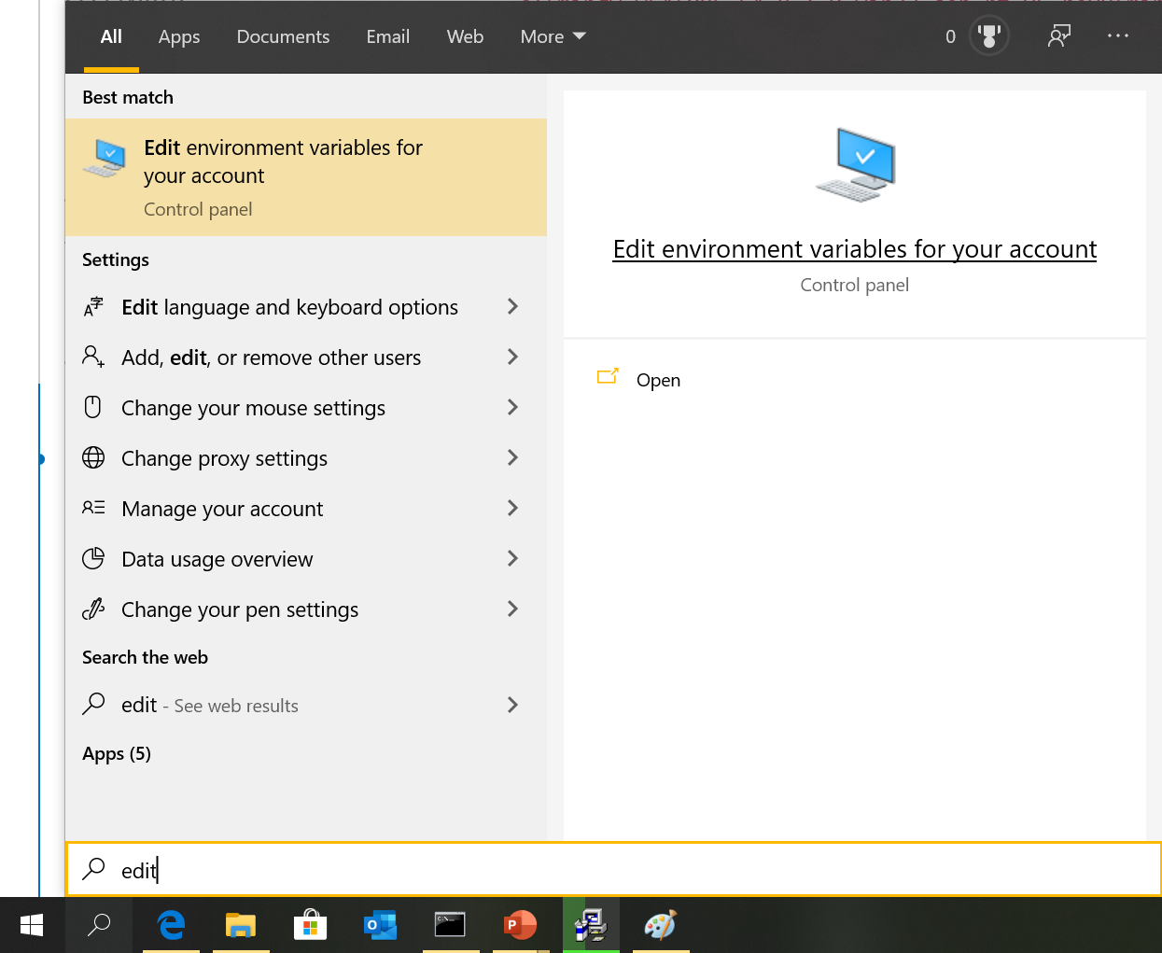
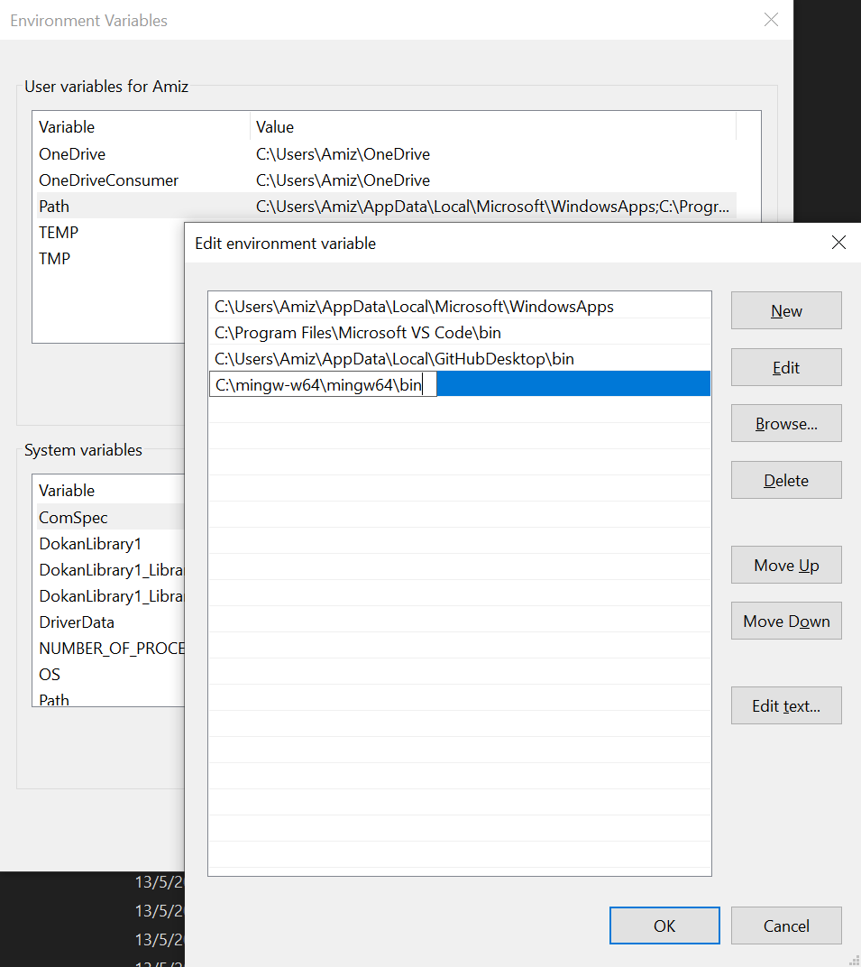
14) Click on Path
15a) Click on New
13) Click on Edit environment variables for your account
15b) Paste the mingw64 bin folder link
12) Type “edit” on the search bar)
16) Click on okay

Slide 18
Create workspace folder
Create a workspace folder for all your AnT programming files in the documents directory and named “sandbox”.
Create another folder in the sandbox folder for all you C files by naming it “C”
Please refer next slide for more info.

Slide 19
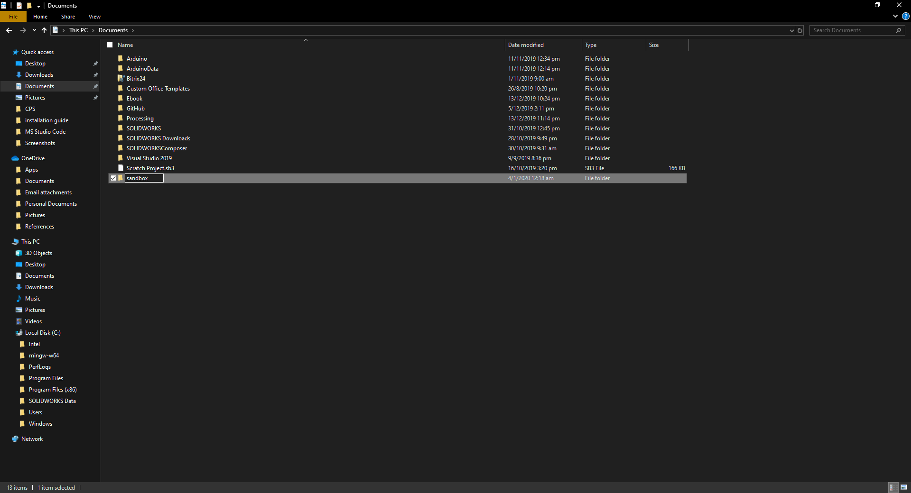
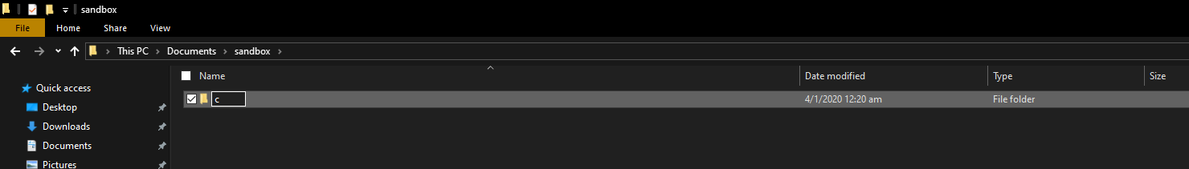
17) Create a folder name “sandbox” on your document directory
18) Create a folder name “c” on sandbox directory

Slide 20
Hooray! Good job!
You have successfully installed the necessary files for C programming. That’s not so hard right? Don’t worry about the installation for other programming language. It will be simple than this!
Do note that there will be setup needed (not necessary) to build and run C files. The reason for the setup is to make compiling and running C files fast and easy. The steps will be explain later when you compile and run the very first .c file (SimpleHelloWorld.c)
Click here to return to Table of content
Click here to return to Installation and setup guide content page

Slide 21
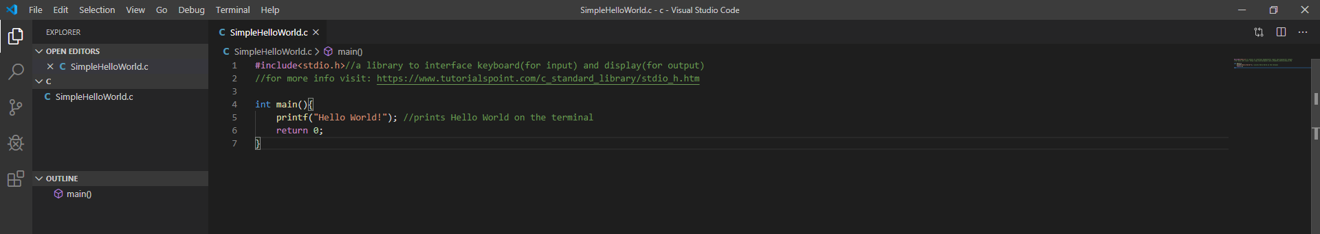
First Program – Hello World!
In this section, we will learn how to compile and run C files. At the same time, we will learn the convenience of creating task file to compile and run C file.
Hello world is a standard program for all programmers when they run for the first time for a new programming language. Click here to download the C file and save it on your workspace folder which you’ve created earlier. Followed by right clicked your workspace folder and lick on “Open with Code”. Your screen should display as per below
The .c file in the c folder which you’ve created earlier

Slide 22
Compile & run (part 1) – Type commands
Now we going to compile the program. The method we going to go apply is the typical method to compile C file whether through MSVC terminal or command prompt.
Steps:
Click on “Terminal” on the upper left corner of the screen and select “New Terminal”. There should be a terminal display on the below of your screen.
Type the following command on the terminal
> gcc -g filename.c –o filename.exe
This command will compile and create an .exe file on the left.
To run the program, just type the following command
> ./filename.exe
You should see the output on the terminal
Hooray! You just run your very first C program!
EXTRA: For more information on GCC commands, you may click here.

Slide 23
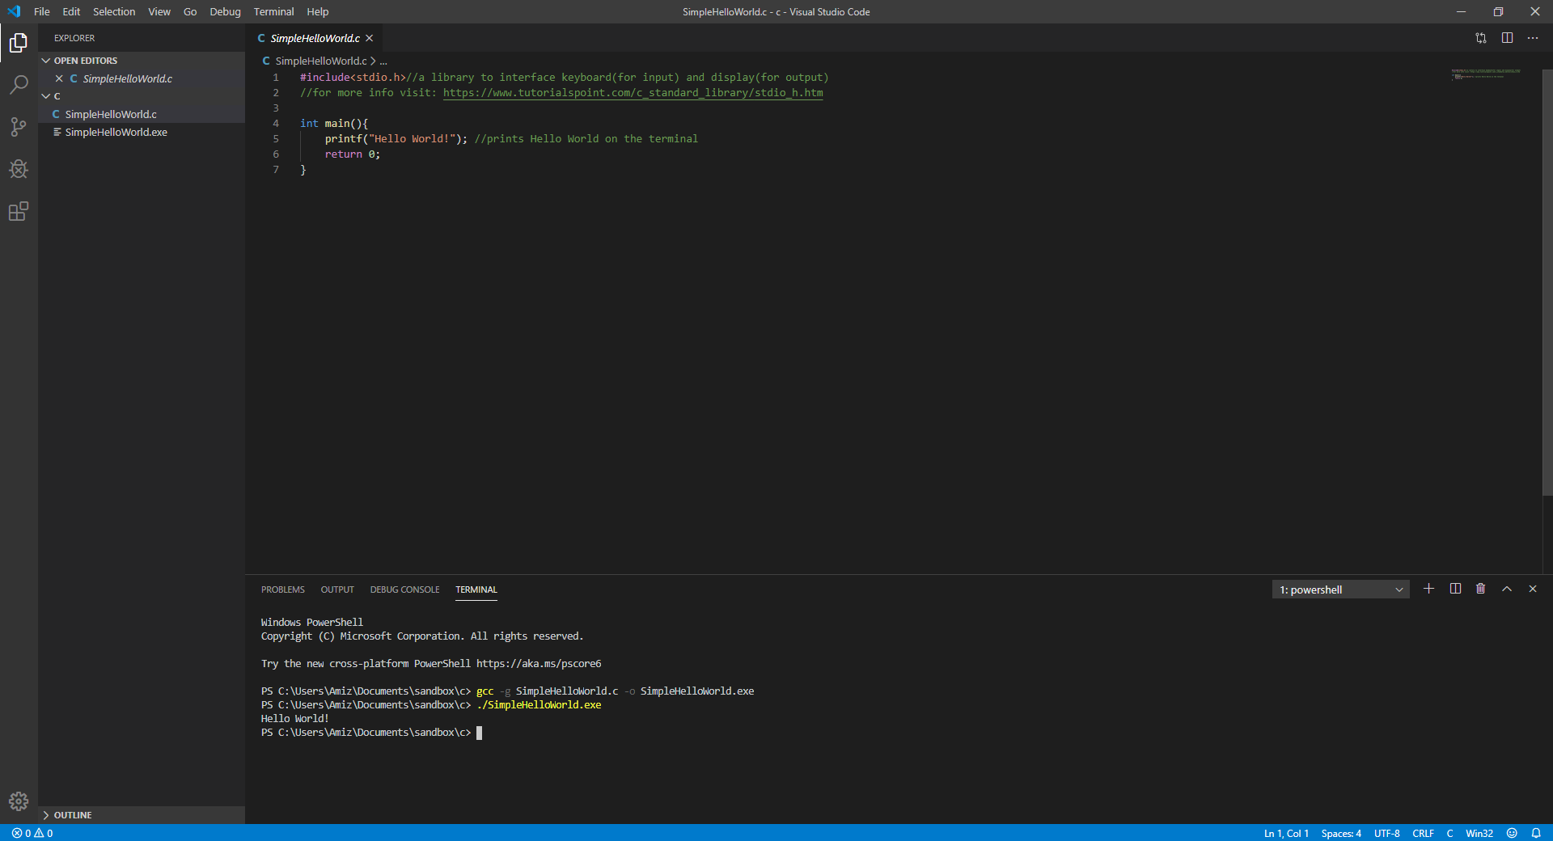
Click here to return to Table of content
Click here to return to Installation and setup guide content page
3) .exe file created after compiling
1) To open terminal
2) Command to compile the code
5) The output from the program
4) Command to run program

Slide 24
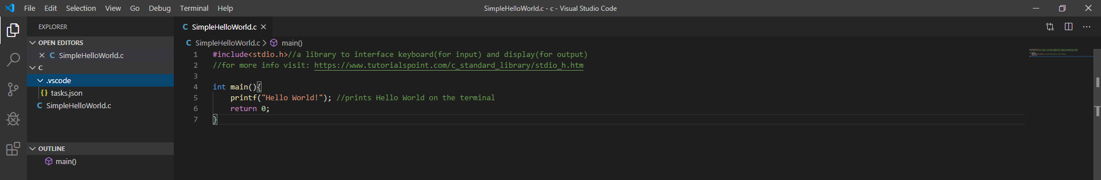
Compile & run (part 2) – Commands by task
You must be wondering by now that whenever you need to compile c file, you need to type gcc -g filename.c -o filename.exe right? Yeap! And I know its troublesome especially when you trying to debug a program. No worries, in fact Microsoft Visual Studio Code have made our job simple by giving us options to customize tasks!
Click here to download these customize tasks just to compile and run c files. Extract the .zip folder into your workspace folder! NOTE: Do not modify anything on these files! This file is build according to what you require for this course. IF you wish to learn more, click here on tutorial to build your own task files. Delete both .zip and .exe file right after you’re done extraction.
You should have a folder named .vscode which contains task.json file

Slide 25
Compile & run (part 2) – Commands by task
Now, you may follow the following step to compile and run the filename.c again!
Click on the filename.c to open the editor.
Click on “Terminal” on the upper left corner of the screen and select
“Run Task -> compile C file -> Continue without scanning for tasks output”
You should see the .exe file created on the left of your display.
Next, Click on “Terminal” on the upper left corner of the screen and select
“Run Task -> run C file”
You should see the output of the file on the terminal

Slide 26
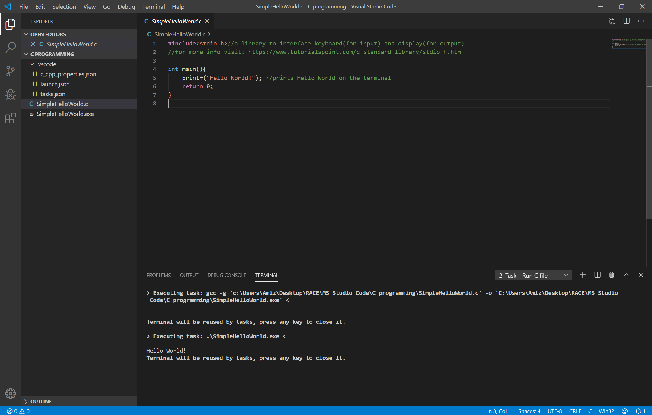
Click here to return to Table of content
Click here to return to Installation and setup guide content page
1) Click on filename.c to open editor
3) Output after compile file using task
5) Output after run file using task

Slide 27
Compile & run (part 3) – Keyboard shortcut for tasks
Well, we have simplify the compile and run process by include the tasks.json file. Wouldn’t it be nice if these task can be execute using keyboard shortcut instead of clicking of mouse? Of course you can! Follow the following steps to create the shortcuts for both “Compile C file” and “Run C file”.
Steps:
We need to access the “Keyboard Shortcuts” tab. To get there, on the top left of the display, click the following
“File -> Preferences -> Keyboard Shortcuts”
Now we have access the “Keyboard Shortcuts” tab. On the top right of the display, hover the mouse over the icon that indicate “Open Keyboard Shortcut(JSON)”
This will open a new tab which is called keybindings.json
copy the code on the next slide to your keybindings.json tab and save the file

Slide 28
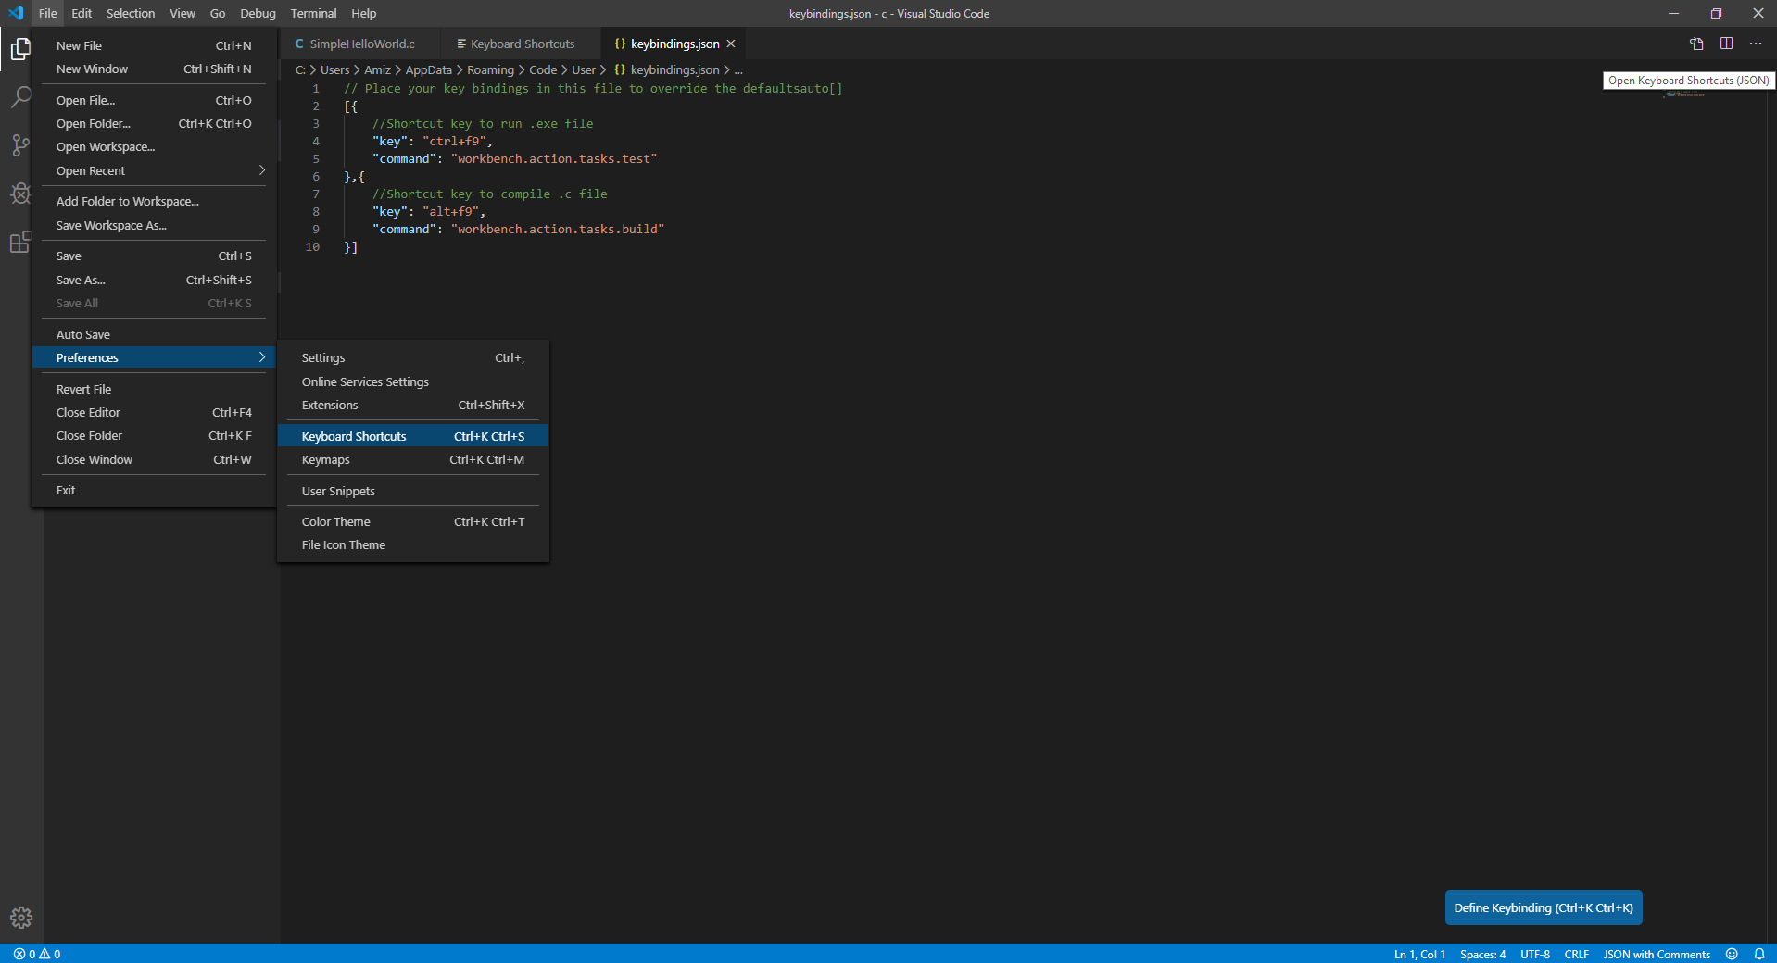
2 & 3) To open “keybindings.json” tab
4) Copy these codes on your “keybindings.json” tab
1) To access “Keyboard Shortcut” tab

Slide 29
Compile & run (part 3) – Keyboard shortcut for tasks
Now you may leave the filename.c open and close the rest of the tabs. What you have done is to create shortcut for:
( “Compile C file” == alt + f9 ) and ( “Run C file” == ctrl + f9 )
Delete the filename.exe which can be found on the left of the display and try to compile and run using keyboard shortcut! Try these before proceeding to the next section.
Click here to return to Table of content
Click here to return to Installation and setup guide content page

Slide 30
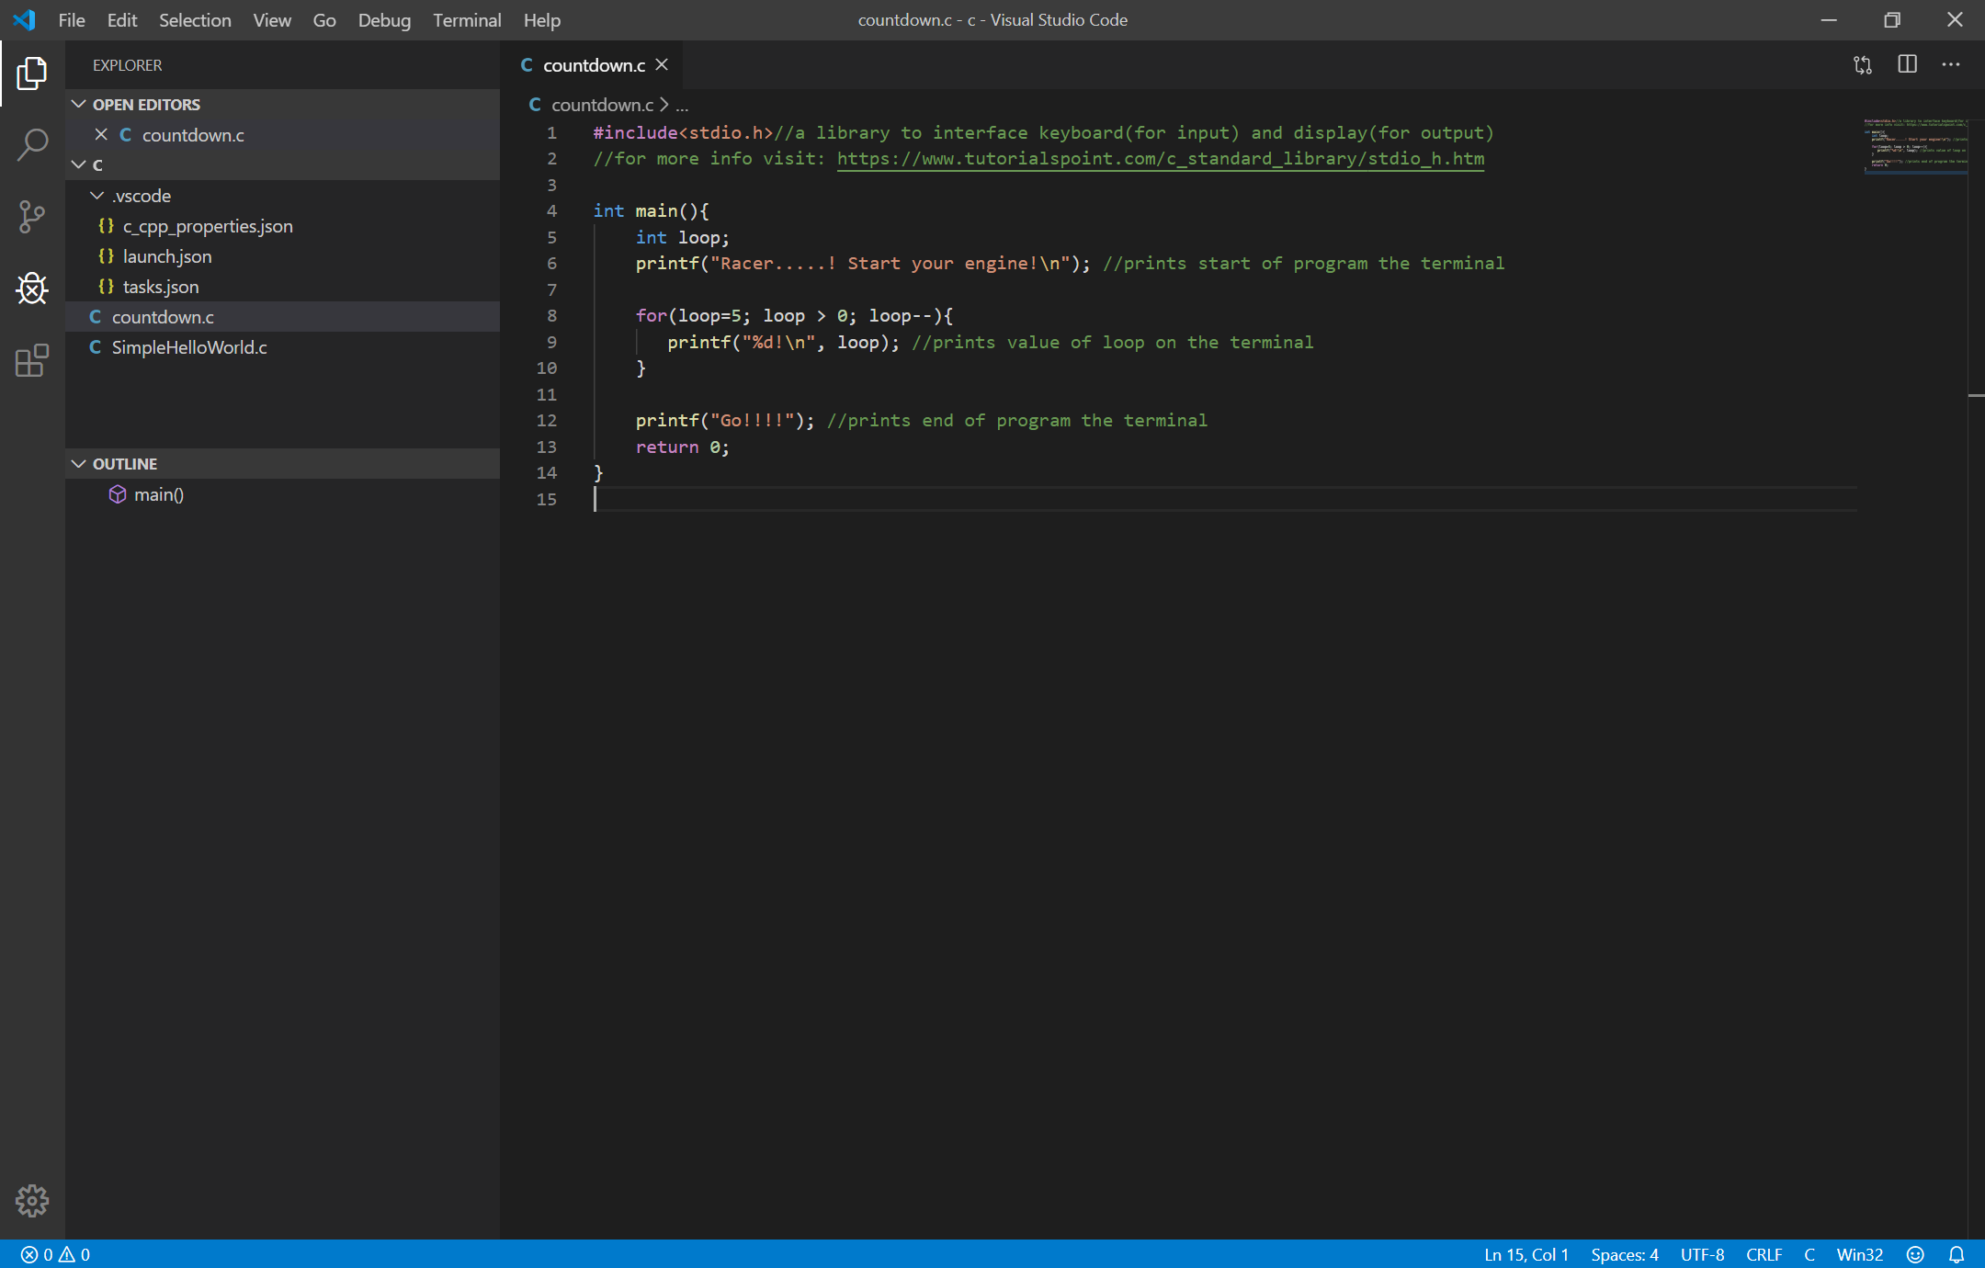
Debugging setup
Now we left one last and important step for C programming which is the debugging setup. It is very important setup especially when you want to find which line of code that makes your program doesn’t behave the way you intended it to be.
Click here to download these debugging configuration files. Extract the .zip folder into your workspace folder. When you are prompt to override the folder, click “yes” to overwrite. NOTE: Do not modify anything on these files! This file is build according to what you require for this course. IF you wish to learn more, click here on tutorial to setup debugging configuration file. Delete .zip once you have done with extraction. Next, click here to download the .c file for this section

Slide 31
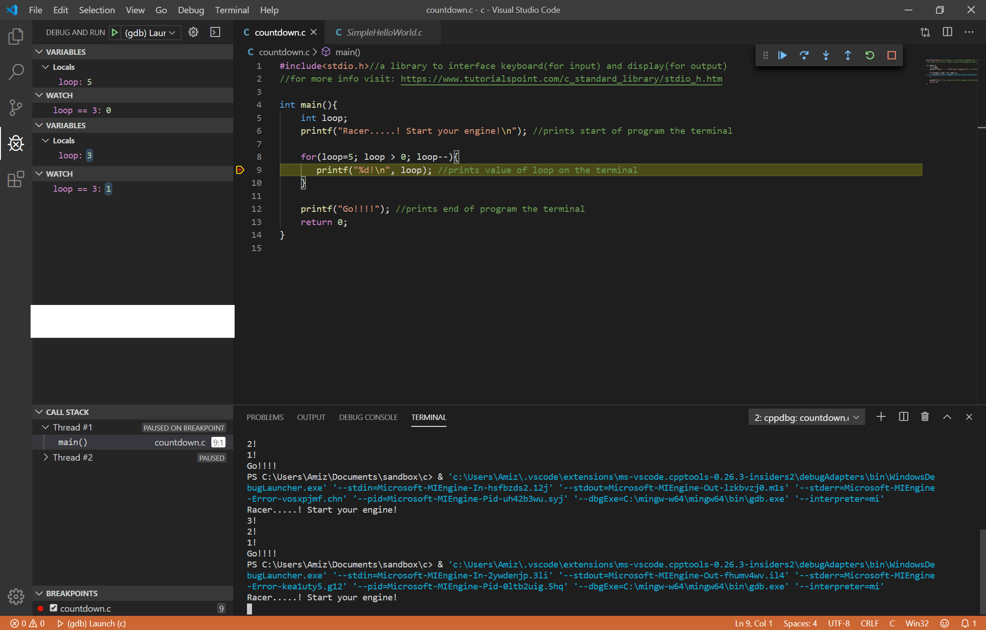

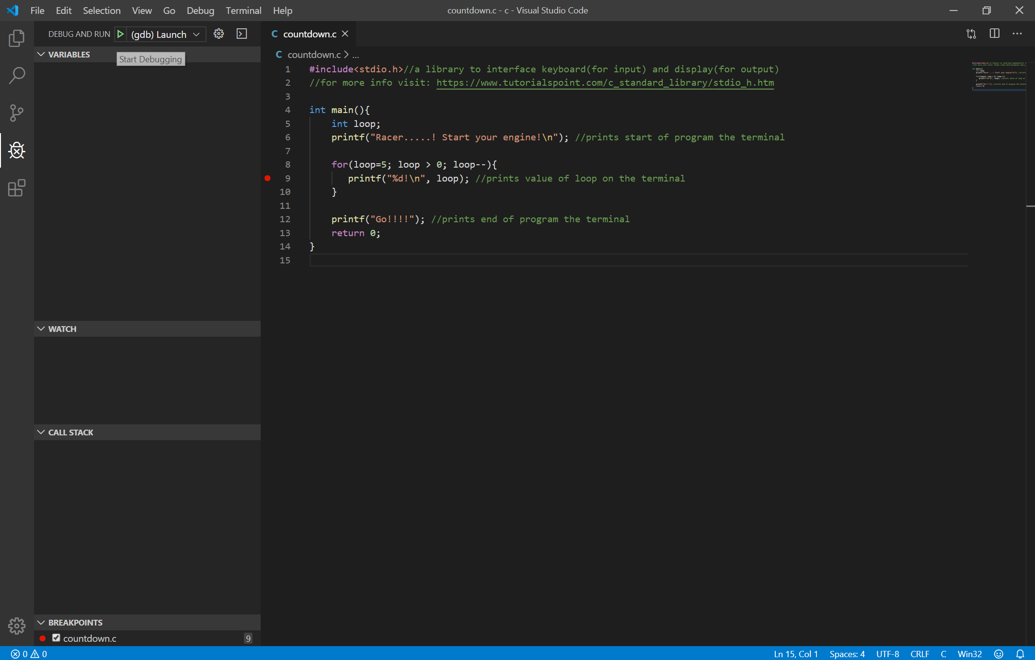

Debugging process
Here are some explaination on the tools which will be frequently use for debugging. For further details on debugging with visual studio code, please visit here and here.
Variables and watch
Variables displays the variables in a program and its values can be changed by right click -> “Set Value“
Watch evaluates the variables and expression to show an event happen either 0 (false) or 1 (true)
Breakpoints
It pauses the program when the program run into the “red dot“ in the program.
You can add breakpoints by clicking the red dot on the left side of the code line number.
Debug actions
Continue/Pause program will run until meets breakpoint.
When a programs runs on a line of code that is a function call,
Step Over executes the function and breaks after the function return.
Step Into will executes nested functions and run one line at a time.
Step Out will skip function call and breaks after the function returns
Restart will revert debugging from start of the program
Stop ends debugging process

Slide 33
C Basics content
C Fundamentals
Statements;
Functions()
#Directives

Slide 34
C Fundamentals
By now you have seen 2 .c file (which are SimpleHelloWorld.c and countdown.c). However, there is no explanation on the fundamentals of a C program. In this section, the basics of c will be explained to a point that is required for this program. There will be links for you to learn more on each topic. Before we begin, I would like to share a very important quote regarding learning programming.
"The only way to learn a new programming language is by writing programs in it." - Dennis Ritchie
In order words, to be confident writing a program; you need to keep practicing! So without further a do, Let’s start learn the very basics of C which is the layout!

Slide 35
C Fundamentals
The general form of C consists of the following:
#Directives
These are commands intended for the preprocessing. Directives always begin with #. More…
Functions() {}
They are like “procedures” or “subroutine” or even building blocks. A function comes with open and close brackets. More…
Statements;
These are commands to be executed when the program runs. Each statement in a programs ends with a semicolon. More…
/*Comments*/ or // Comments
It is a form of documentation so the program can be maintain not only by original author of the program by other programmers as well.
If you notice, the colour convections above are similar to MSVC’s program colour convections.
Click here to return to Table of content
Click here to return to C Basics content page

Slide 36
Statement;
Wow! Finally we’ve reached the simple but the biggest topic of the C programming. Statements are basically commands to be executed by the program. Statement can fall into the following:
Expression;
Selection statements;
Iteration statements;
Jump statements;
Function calls;
Data structures;

Slide 37
Statement - Expression;
Operators are the basic tools for building expression. There are so many operators in C but we will touch on the following which will be sufficient for the course. They are:
Declaration
Furnish information to the compiler the meaning of identifiers in the program.
Operators
Assignment
Assign a value to a memory/variable.
Arithmetic
Performs addition, subtraction, multiplication and division.
Relational
Test the relation between two variables and returns a value of “true” or “false”.
Bitwise
Performs bit by bit operations. For more information click here.
Logical
Test the value of an expression and returns a value of “true” or “false”.
Miscellaneous
sizeof, reference, dereference, ternary , cast(known as type casting) and comma operators.
Let’s look at each of these operators and what kind of result to expect when these operators are executed.

Slide 38
Statement – Expression (Declaration);
Any operator commands that requires assigning a value to a variable, requires the variable to be declared first. A general form of declaring a variable is:
declaration specifier declarator = initializer;
For a detail form and information on declaring variables, click here.
Declaration specifier describe the properties of the variable or function being declared and it falls into three categories Storage classes, Type qualifiers and Type specifiers. In this course, you will commonly come across type specifiers with basic types and type void. You may define your own type using a feature known as a type definition. Do note that C allows conversion of basic types, this is known as type casting.
Declarator is basically identifiers(labels) for the storage location. There are rules to naming the declarator, click here to know more. The simple rule for naming your declarator is that if on MSVC defines your declarator as colour convection for declaration specifier, that declarator(label) is a no go or basically is an illegal declarator.
Initializer specifies the initial value for the variables we declare. This is optional but beware of its pitfall if its not initialize. Without initializer, the content in the variable contains garbage value and your code may not behave as it’s intended to be.
Assignment operator

Slide 39
Statement – Expression (Declaration);
One must take note that file scope of a variable determines the existence of the variable when the program runs. File scope of a variables can fall into two categories:
Local
These are variables that are declare in the functions and it’s values does not retain once the program exit out from the function. At the same time the variable can’t be access by other variables unless the usage of pointers.
Global
These are variables that are declare outside of functions. Meaning they do not belong to any function. It’s value retain through out the program and can be access on all function in the program.
Therefore, with the explanation done earlier, Let’s try see some example to understand the better
Example1 Example2 Example3 Example4
Click here to return to Table of content
Click here to return to C Basics content page

Slide 40
Statement - Selection;
Selection statements are paths of the program to execute if the conditions are met. There are generally two types of selection statements:
If…else statement
It has a form of
if( relational / logical operator expression ) {statements}
else {statements}
switch statement
It has a form of
switch( integer / char expression )
{case constant expression: statements; default: statements;}
The above are the basic form of the selection statement. However, you can nested these statements such as nested if…else and nested switch.
Therefore, with the explanation done earlier, Let’s try see some example to understand the better
Example1 Example2
Click here to return to Table of content
Click here to return to C Basics content page

Slide 41
Statement - Iteration;
The purpose of loop statements is to perform repeated statements over a certain interval. There are generally three types of loop statements:
while statement which has a form of
while(relational / logical operator expression){statements;}
do while statement unlike while statement, the statements in the loop is executed once before check condition. It has a form of
do {statements;} while(relational / logical operator expression);
for statement which has a form of
for( initialization; control loop termination ; commands/end loop ){statements;}
The above are the basic form of the loop statement. Just like the previous topic, nested loop statement are legal in C. Depending on your application, it is possible to perform infinite loops by making the controlling expression true. Let’s try some example to understand iteration statements!
Example1
Click here to return to Table of content
Click here to return to C Basics content page

Slide 42
Statement - Jump;
These statements are capable of change the execution from the normal sequence.
break statement it is used to exit the body of the loop
continue statement although it doesn’t exit the loop, it skips commands after the statement until the end of the body loop.
goto statement is capable to jump any statement in a function provided the statement has a label.
Lets see examples to understand the concept of jump statements.
Example1
goto statement has a form | a label which has a form of
goto identifier; | identifier: statements;
Click here to return to Table of content
Click here to return to C Basics content page

Slide 43
Statement – Data structures;
So far you have come across variables that are scalar, capable of holding single data item. C also support aggregate variables, which can store multiple values. There are two kinds of aggregate:
Arrays
Arrays are data structure containing a number of values, all of which have the same data type.
Structures
Unlike array, structures have members of which they have different data types. To access members are different compared to arrays.
Unions
Unions are similar to structures. However they have known for better utilizing program space!
Enumerations
For variables that have unique set of values (of course with the same data type) we will utilize this feature. It is almost similar to Arrays but have a different properties.
Lets observe some example to understand each of these data structures.
Example1 Example2 Example3 Example4
Click here to return to Table of content
Click here to return to C Basics content page

Slide 44
Functions()
What do you think about the three examples provided earlier? Was it easy to read or understand? Let’s keep that thought and see if you think the same after we’ve done with this topic.
There are two categories of function:
User functions
These are function written by the programmer.
Library functions
These are functions which are available once it’s header file is include in the program. We have covered C built in libraries here.
NOTE: the int main() or void main() function is unique cause it is the mandatory function. Without it, the program won’t begin or start.

Slide 45
Functions() – User function
As mention earlier, functions are block of statements that perform once particular task. A general form of a function is as below:
Function Definitions (is done before/after the main() function):
return data type function name (input data type input data label)
{Blocks of declaration and statements;}
NOTE: If the function definition is done after the main() function, it is mandatory to include function declaration before the main() function.
Function Declaration (is done before the main() function ONLY when the function definition is done after main() function):
return data type function name (input data type input data label);
When the return and/or input is a void data type, it refers that the function doesn’t return value and/or require any input.
Function call (call is done in the main()/user defined function):
function name(input variable/s or leave it empty if it’s a void type);
parameters
arguments

Slide 46
Functions()
That is all about function! The purpose of the function is for easy reading, maintaining, modifying and reusable for any part of the program.
Let’s use the earlier examples (example1 and example2) and reorganize the program. This time, let’s see if you have the same opinion regards to the program’s readability before we start this topic on function(). Below examples are the examples which have been reorganize. Compile and debug to understand the purpose of functions in this programs.
Example1 Example1_new Example2 Example2_new
So, does reorganizing the programs into functions make it simple to read and modify the program?
Click here to return to Table of content
Click here to return to C Basics content page

Slide 47
#Directives
Preprocessing directives falls into three categories:
Macro definition
#define directive defines a macro. It makes programs easier to read and modify.
File inclusion
#include directive causes the contents of a specified file/library to be included in a program. These files are called header(.h) files. There are two types of header files are the C built in libraries and libraries written by the programmer.
Conditional compilation
#if, #ifdef, #ifndef, #elif, #else and #endif directives allow blocks of text to be either included in or excluded in a program which depends on condition tested by the preprocessor.
In this course, you will come across macro definition and file inclusion directive. Common mistake made by many newbies, directives do not end with semicolon! Let’s do go through some examples to get familiar with directives!
Example1 Example2 Example3 Example4
Click here to return to Table of content
Click here to return to C Basics content page

Slide 48
Activities
So now you have the necessary tools. It’s time to put your knowledge to work! Do not stress yourself up, the examples provided to you should be sufficient for you to program these activities. You need to write programs in order to be assure the knowledge you have in hand. This activity may not seem easy but if you understood the examples so far, I am sure you are able to do it!

Slide 49
Activity 1 – Data Collection
Assume you’re working for a logistic company. The company is planning to follow the industrie 4.0 transformation. The first task that was given to your was to integrate the shelving system to
You job is to develop a automated guided vehicle agv system pin point its position on the floor operation. Using the below file to combine with your program The below file contains an array of information that tells the position of the agv on the floor

Slide 50







Feedback
Powered by
raceacademy.com.sg
enquiries@raceacademy.com.sg
RACE – Robotics Automation Centre of Excellence
RACE Robotics

